Slide 1
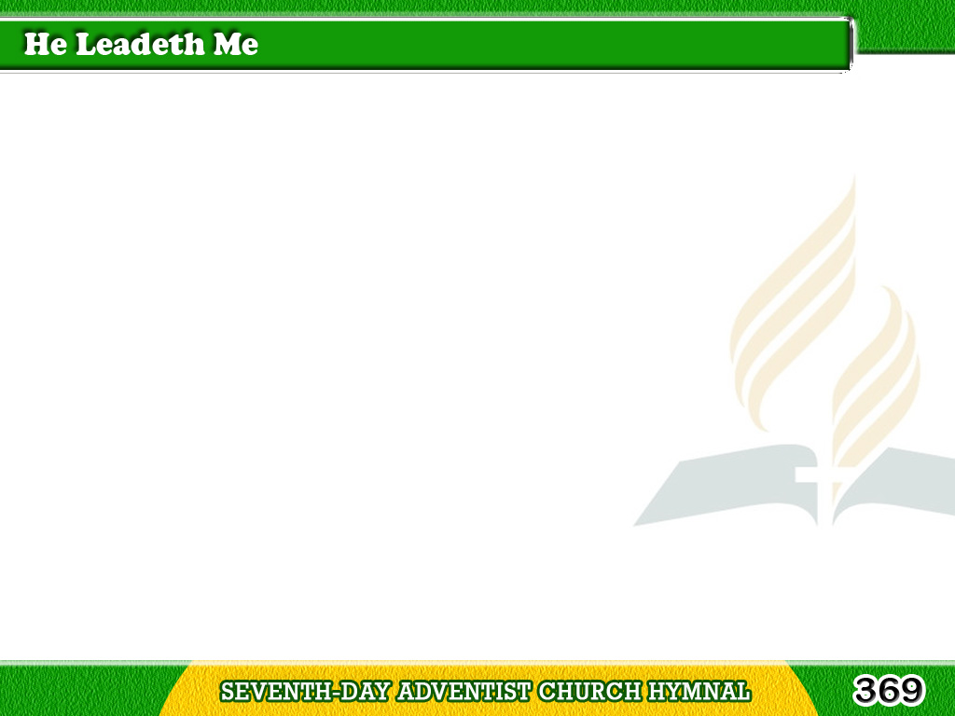
1/4
He leadeth me!
O blessed thought!
O words with heavenly
comfort fraught!
Tagalog
Version

Slide 2
1/4
Whate’er I do,
where’er I be,
Still ‘tis God’s hand
that leadeth me.
Tagalog
Version

Slide 3
1/4
Chorus
He leadeth me, He leadeth me,
By His own hand He leadeth me;
His faithful follower I would be,
For by His hand He leadeth me.
Tagalog
Version

Slide 4
2/4
Sometimes ‘mid scenes
of deepest gloom,
Sometimes where Eden’s
bowers bloom,
Tagalog
Version

Slide 5
2/4
By waters still,
o’er troubled sea
Still ‘tis His hand
that leadeth me!
Tagalog
Version

Slide 6
2/4
Chorus
He leadeth me, He leadeth me,
By His own hand He leadeth me;
His faithful follower I would be,
For by His hand He leadeth me.
Tagalog
Version

Slide 7
3/4
Lord, I would clasp
my hand in Thine,
Nor ever murmur nor repine;
Content, whatever lot I see,
Since ‘tis my God that leadeth me.
Tagalog
Version

Slide 8
3/4
Chorus
He leadeth me, He leadeth me,
By His own hand He leadeth me;
His faithful follower I would be,
For by His hand He leadeth me.
Tagalog
Version

Slide 9
4/4
And when my task
on earth is done,
When, by Thy grace,
the victory’s won,
Tagalog
Version

Slide 10
4/4
E’en death’s cold wave
I will not flee,
Since God through Jordan
leadeth me.
Tagalog
Version

Slide 11
4/4
Chorus
He leadeth me, He leadeth me,
By His own hand He leadeth me;
His faithful follower I would be,
For by His hand He leadeth me.
Tagalog
Version

